Slide 1
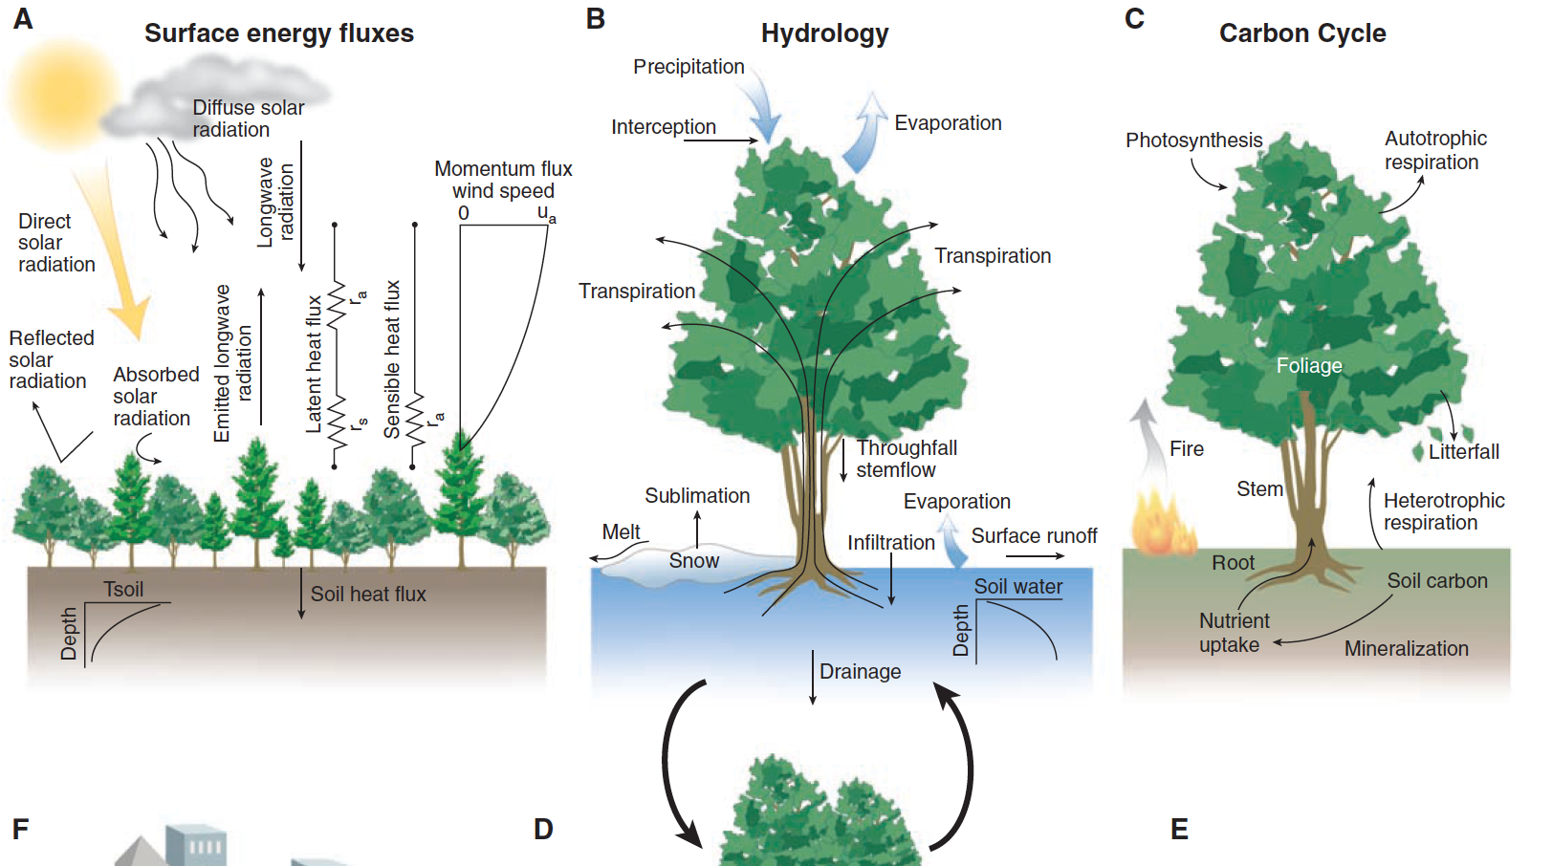
Introduction to G440/540: Terrestrial Ecosystem Modeling
Instructor: Dr Natasha MacBean

Slide 2
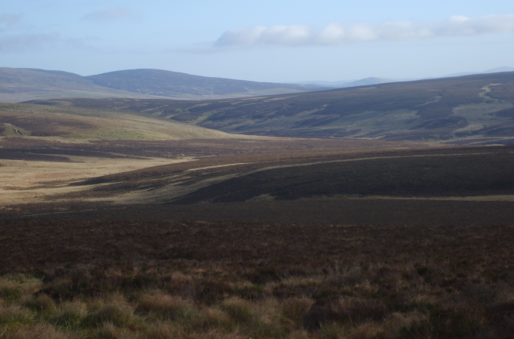


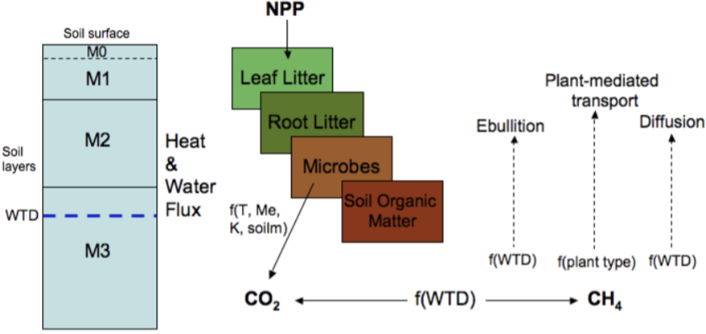

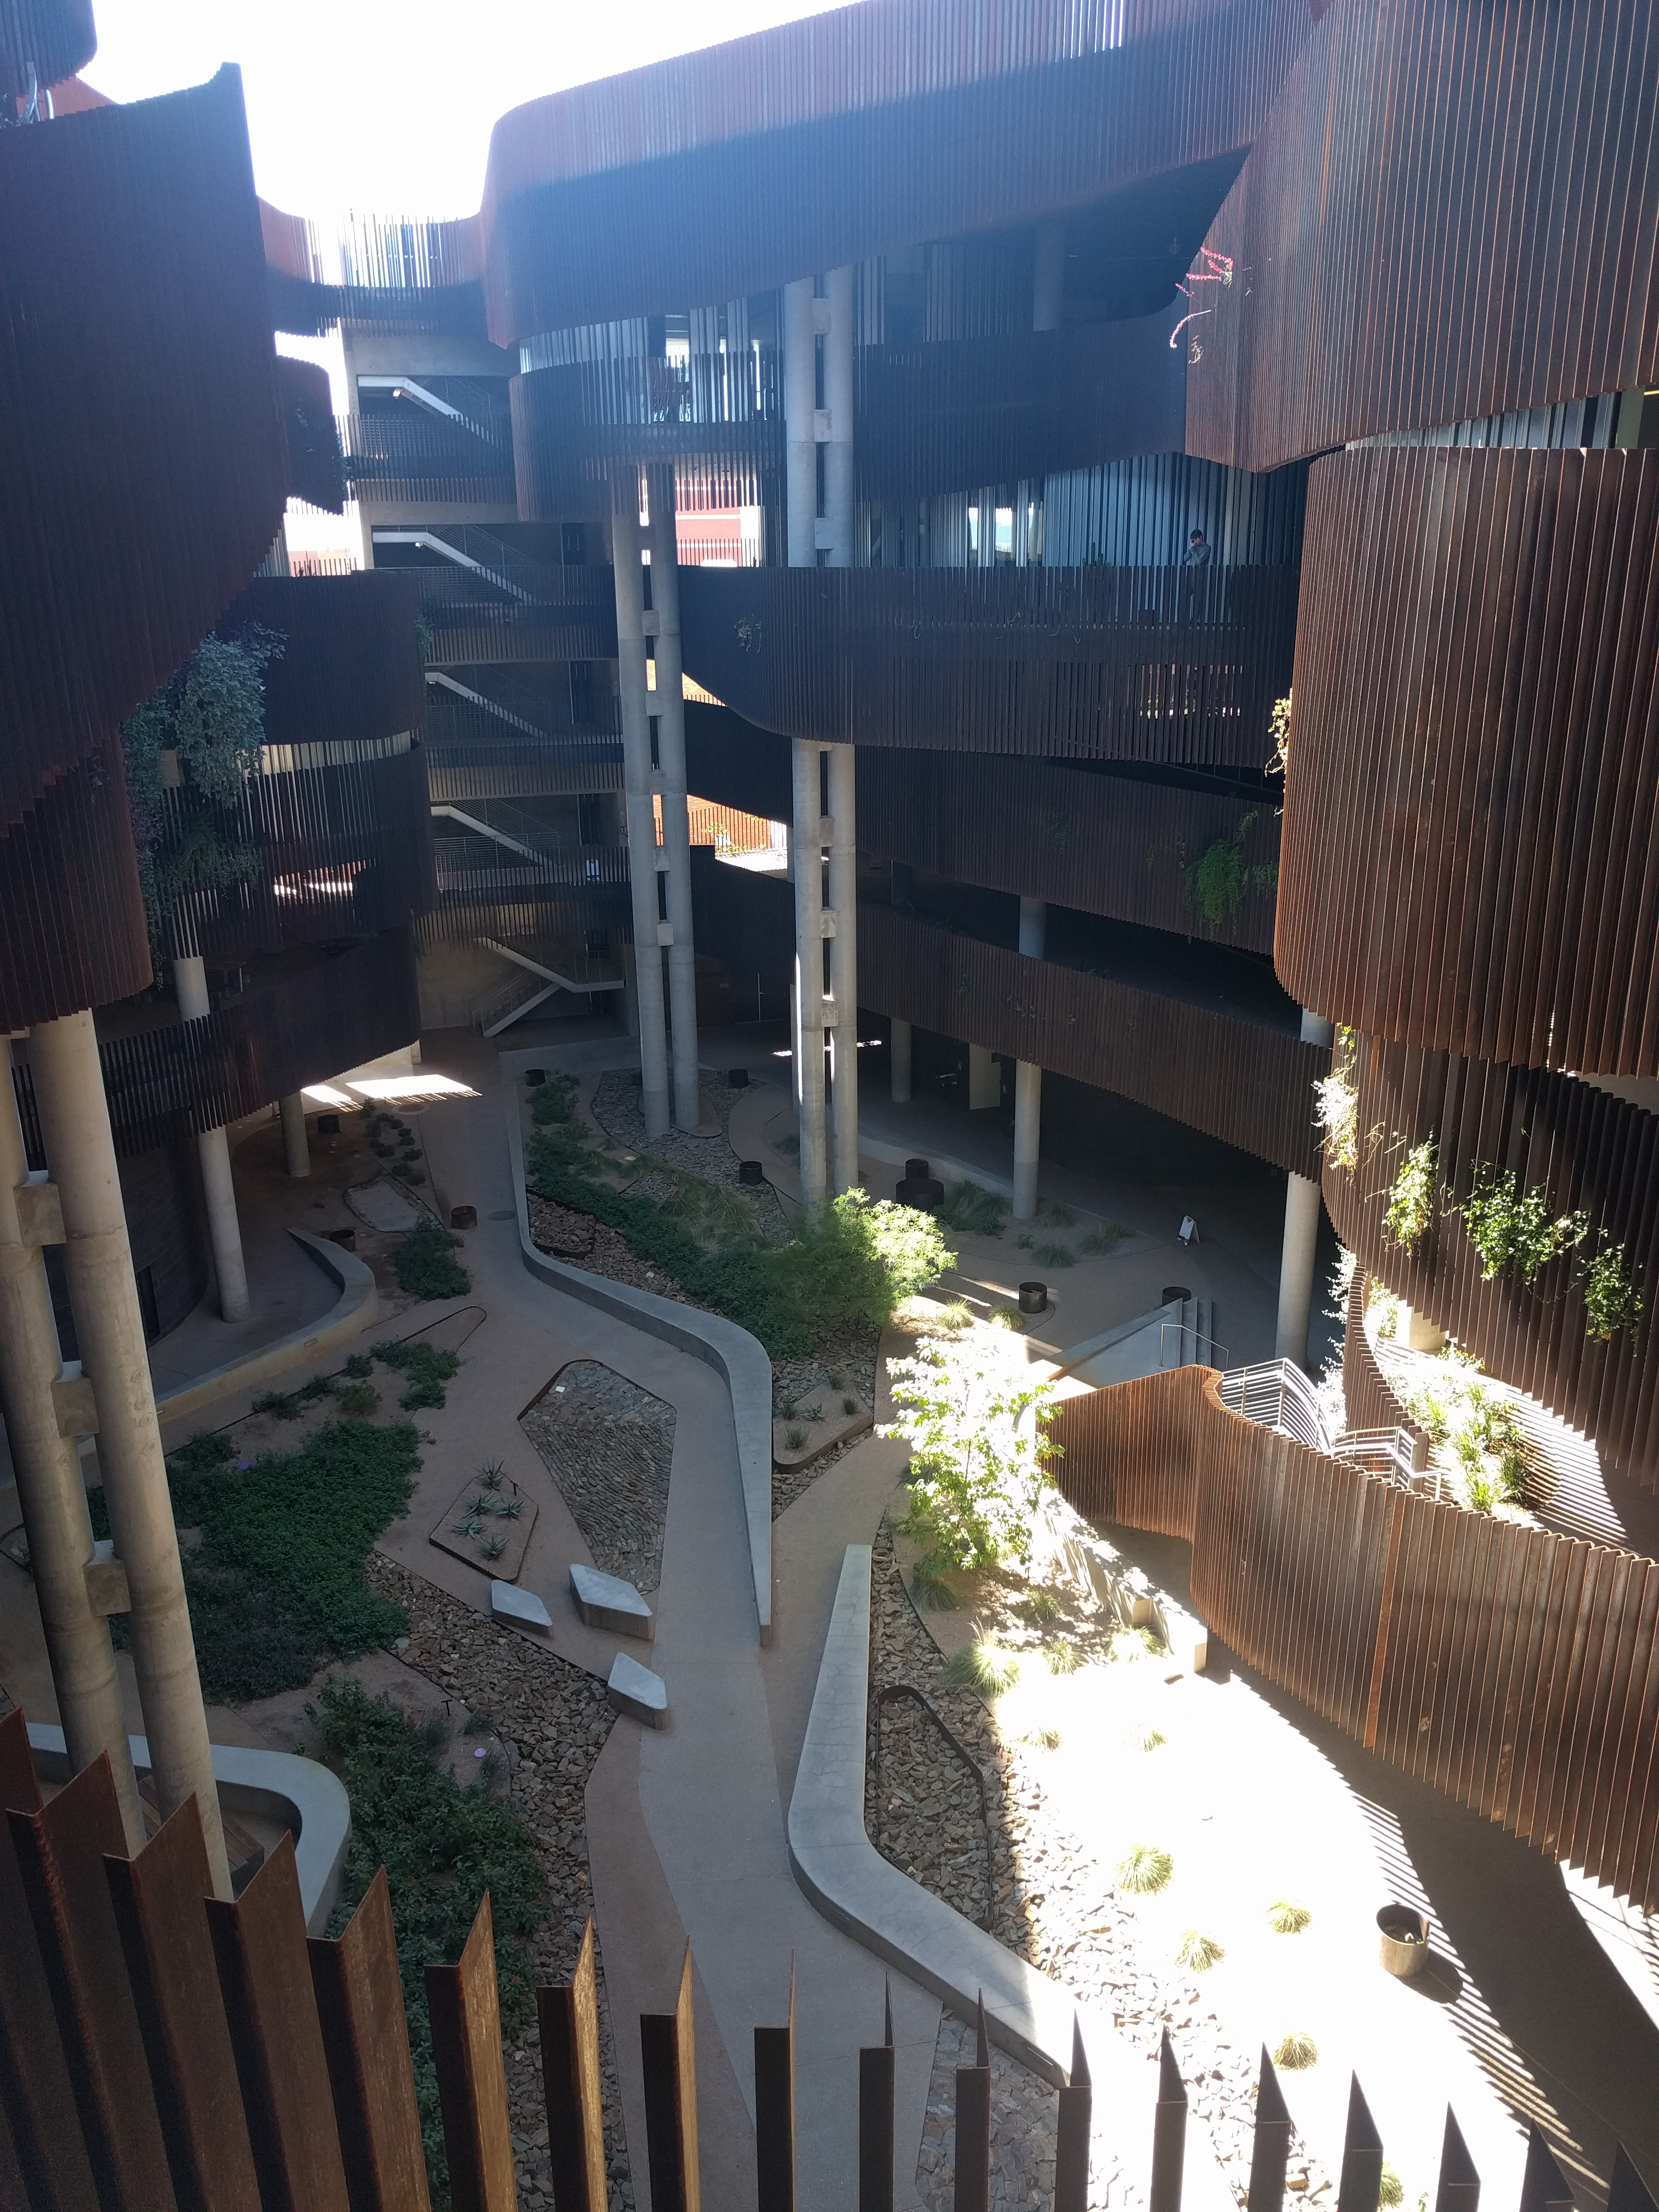

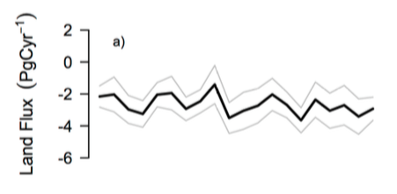
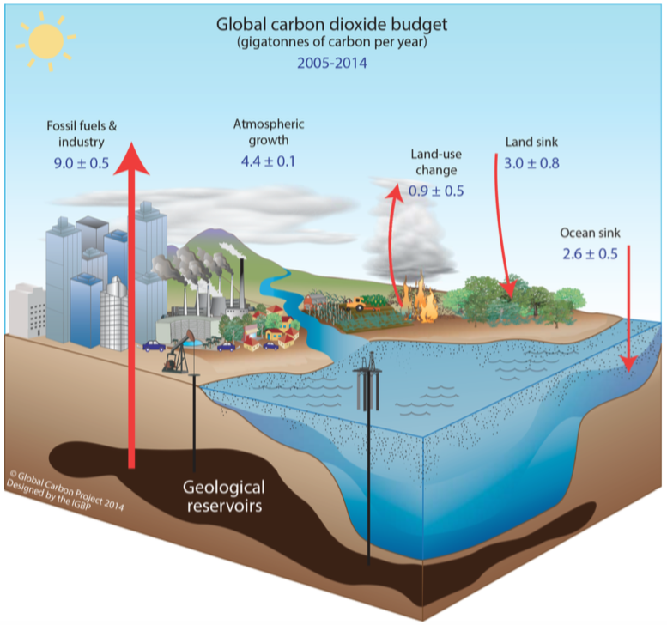
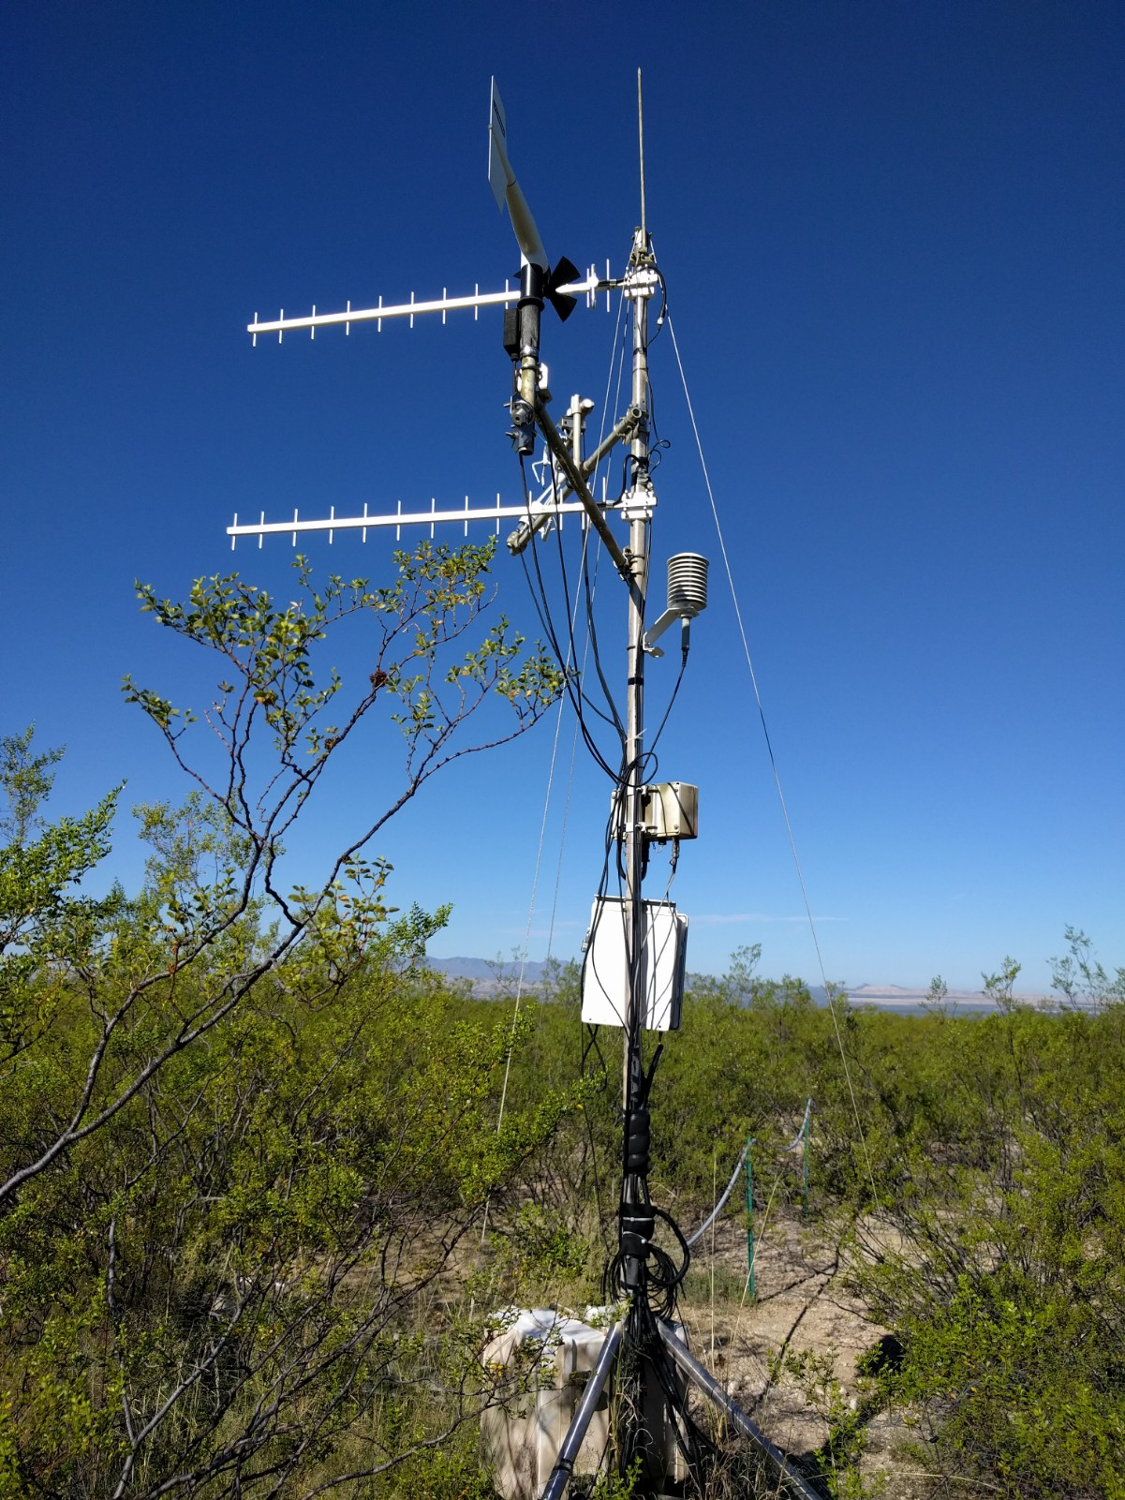
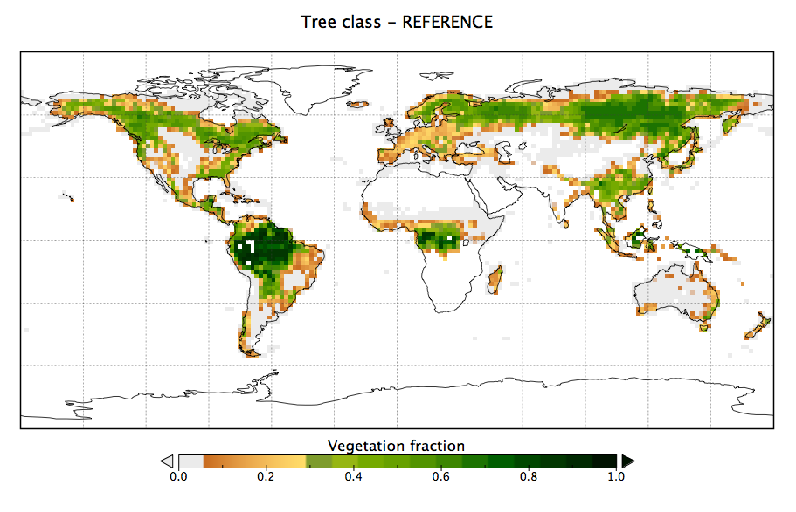
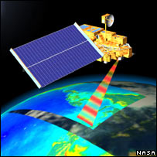
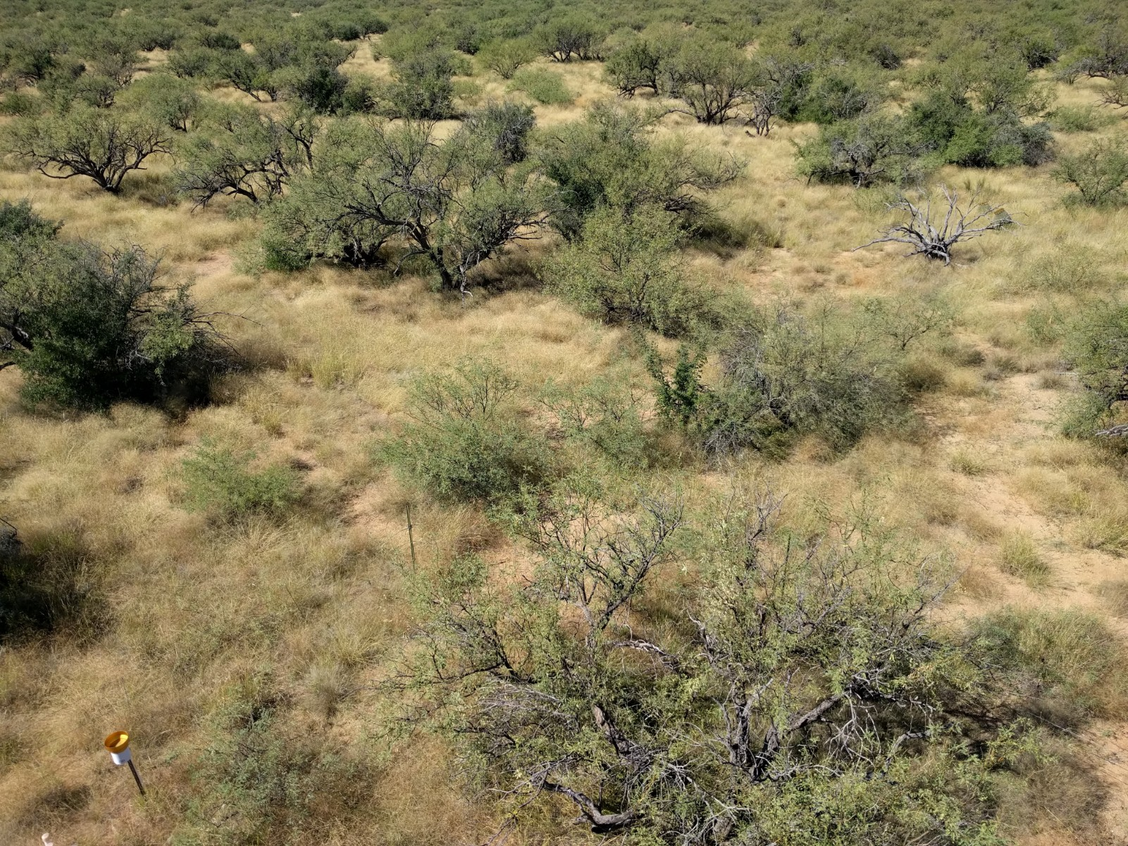
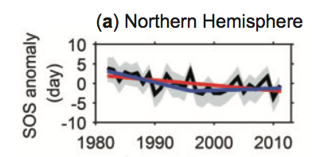


Mini biography and research
Research: Terrestrial ecosystem responses to global environmental change and feedbacks to climate:
https://macbeanlab.com
PhD
Modeling peatland CH₄ fluxes
Data assimilation
Global C cycle + data assimilation
MODIS
Land cover mapping + change
Trends in vegetation dynamics
Semi-arid ecosystems

Slide 3
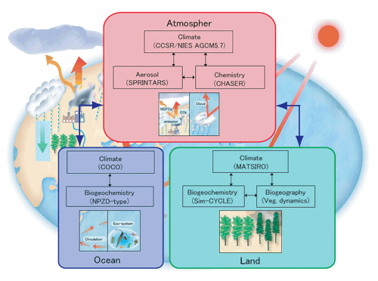
What is a Terrestrial Ecosystem Model?
The land component of an earth system model
Terrestrial ecosystems and physical, chemical and biological processes
Contains hydrology, energy, biogeochemical cycles (i.e. carbon), human activities
Global scale
Used for historical and future projections
Developed from a range of fields
https://www.jamstec.go.jp/kakushin21/eng/team1.html
https://www.carbonbrief.org/qa-how-do-climate-models-work
Notes:
“At their most basic level, climate models use equations to represent the processes and interactions that drive the Earth’s climate. These cover the atmosphere, oceans, land and ice-covered regions of the planet. The models are based on the same laws and equations that underpin scientists’ understanding of the physical, chemical and biological mechanisms going on in the Earth system. Scientists translate each of these physical principles into equations that make up line after line of computer code – often running to more than a million lines for a global climate model.”
(https://www.carbonbrief.org/qa-how-do-climate-models-work)

Slide 4
Other ways we refer to TEMs
Land Surface Models (LSMs)
Terrestrial Biosphere Models (TBMs)
Dynamic (Global) Vegetation Models (DGVMs)
Related to their historical development vs current use
→ We will learn about the differences and similarities on Wednesday

Slide 5
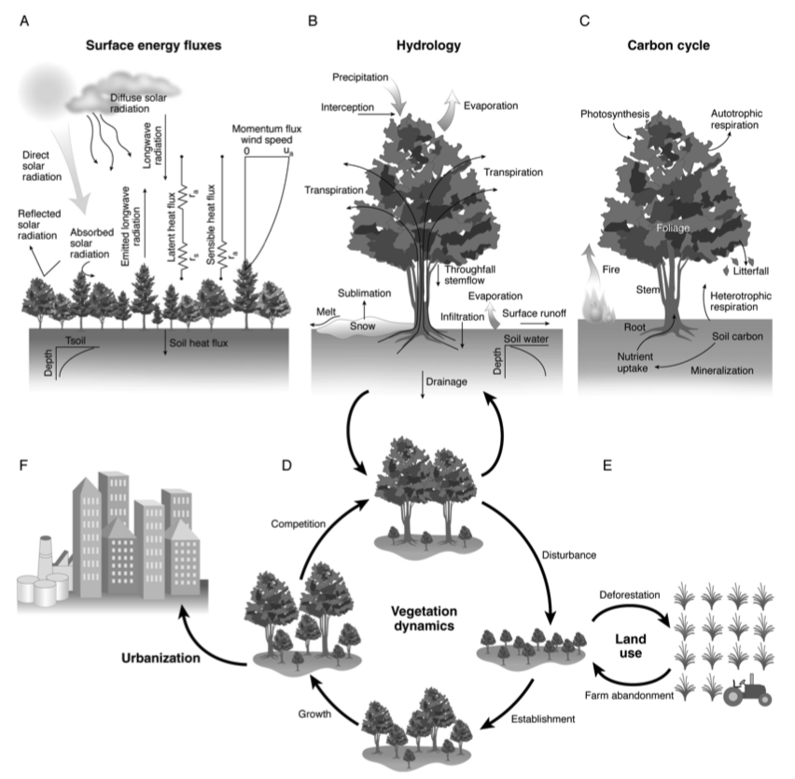
What’s in a TEM?
Bonan, 2019

Slide 6
What are TEMs used for?
Test system behavior beyond measurements
Contains our best knowledge of how interacting systems and processes work.
Response of terrestrial ecosystems to changing climate, rising CO₂ and land use/cover change and management
“Feedbacks” of these terrestrial responses to the climate → influences future climate projections
Short-term: land-atmosphere feedbacks
Longer-term: carbon-climate feedbacks
Can test future “scenarios” of human impacts on biosphere and climate
Can test hypotheses of our process understanding
Research tool to guide data collection

Slide 7
Why study terrestrial ecosystem modeling?
Better understand:
what is in these models
how mathematical models work → simplifications of real world processes
link to your work/research
advantages and limitations of the models
how TEMs fit within earth system models
IPCC climate change projections/reports and impact assessments
latest model experiments → will be in the news a lot over next few years

Slide 8
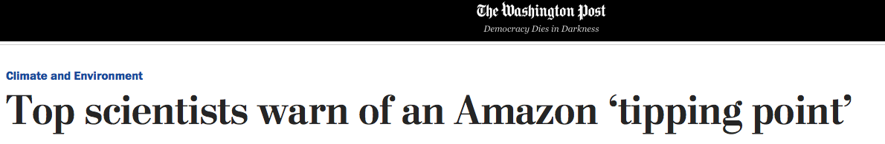
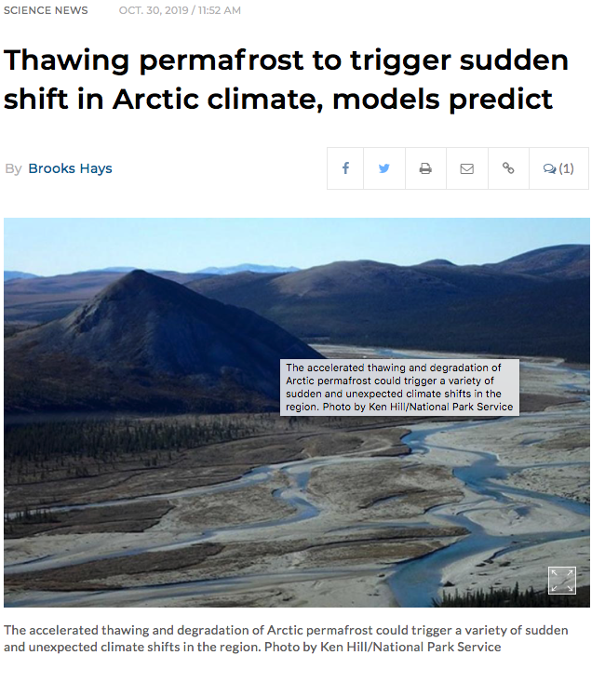
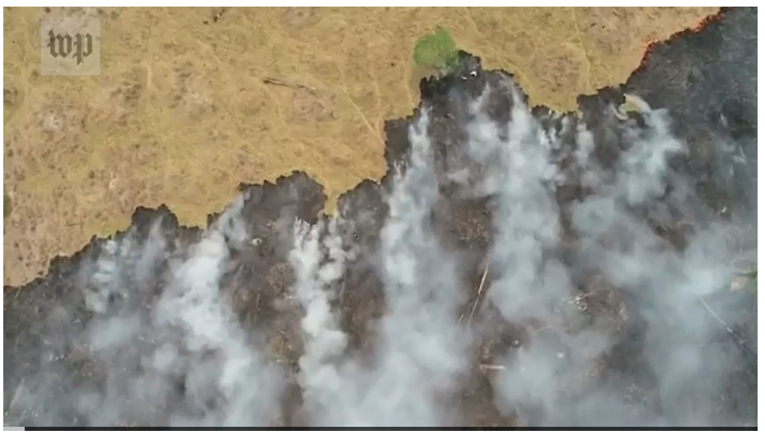
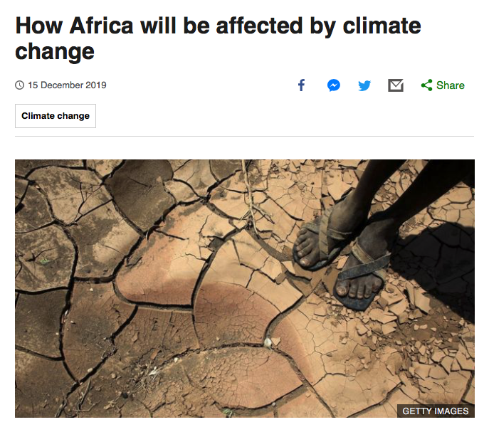
TEMs in the news…

Slide 9
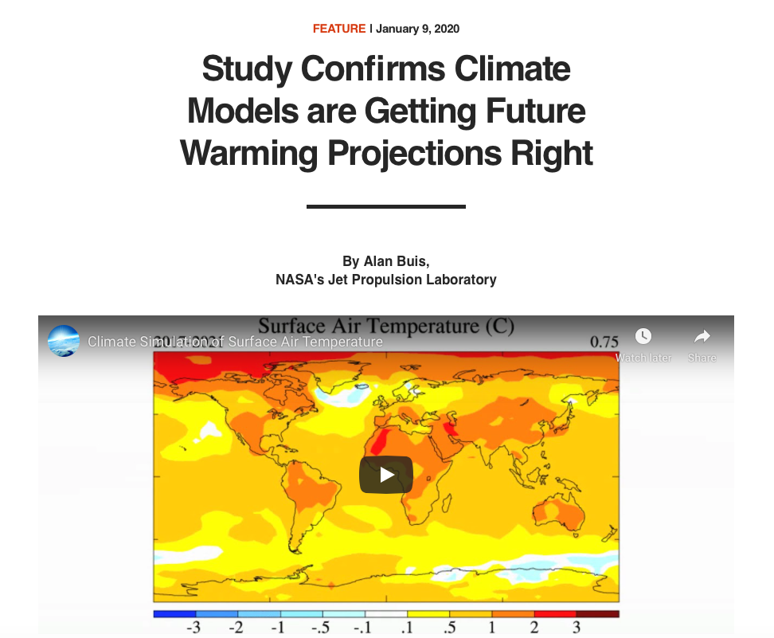
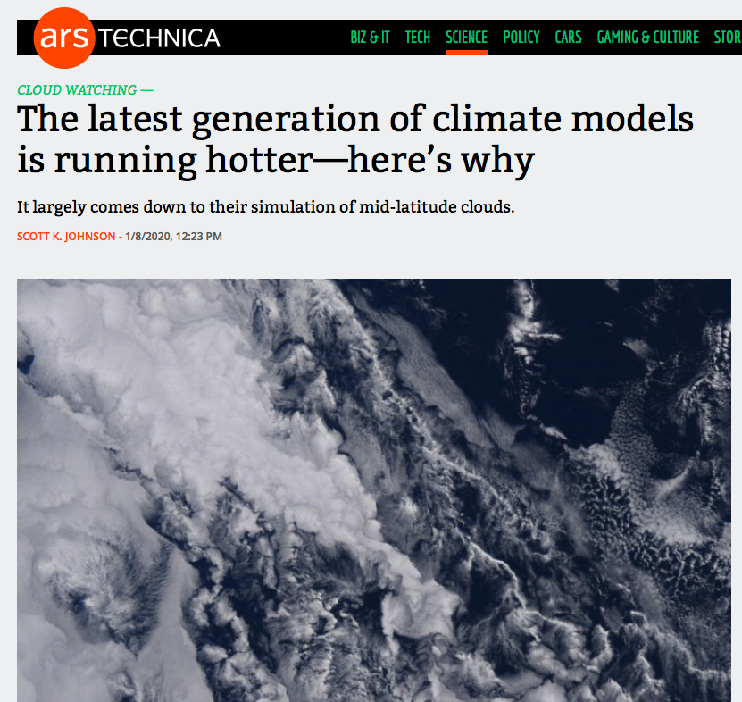
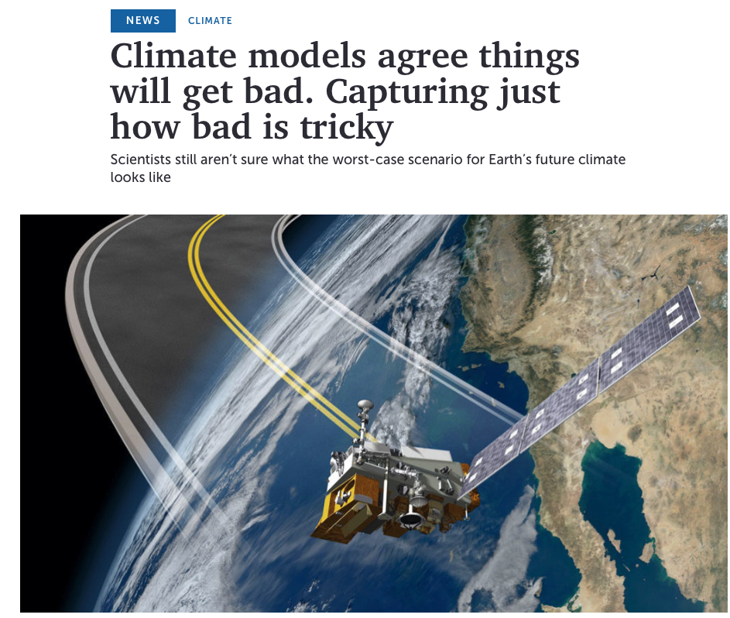
TEMs in the news…

Slide 10
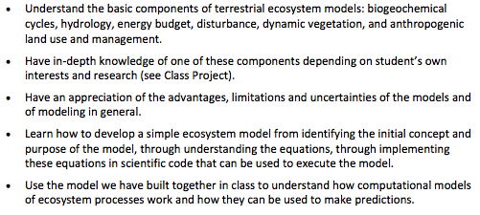
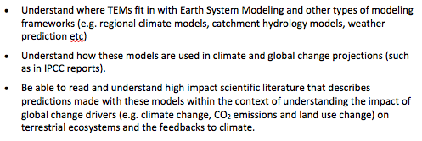
Learning Outcomes

Slide 11
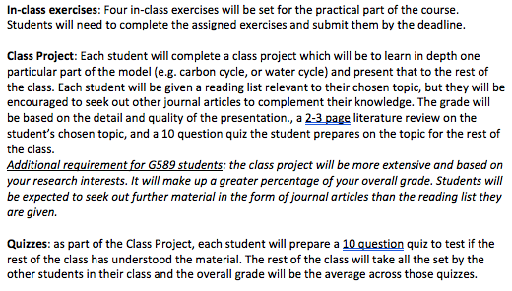
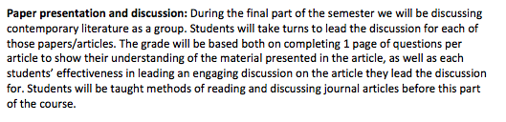
Course format

Slide 12
Course format
No exam in which I will ask you to define certain words or phrases.
Learn from introductory lectures so you can have the knowledge to go on to understand your “in-depth” topic for the class project.
Key take home messages of this course:
Challenges associated to implementing our knowledge of processes into models
Also challenges with the “known unknowns” and the “unknown unknowns” (missing processes)
Models contain uncertainty and complexity → this doesn’t mean their projections are completely wrong! Instead, we just need to have an informed and nuanced appreciation of these issues

Slide 13
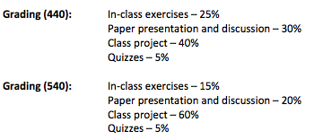
Grading breakdown

Slide 14
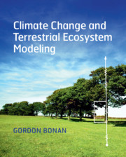
Textbook
Bonan, G. (2019) Climate Change and Terrestrial Ecosystem Modeling, 1st Edition, Cambridge University Press, UK.
Also useful: Bonan, G. (2016) Ecological Climatology: Concepts and Applications. Cambridge University Press, 3rd Edition.
Note: Supplemental readings will be provided on Canvas.

Slide 15
Schedule

Slide 16
Lecture slides…
Numbered
Uploaded to Canvas after each class
Participation…

Slide 17
Class Project
Put together a powerpoint presentation (~40 minutes) focusing in detail on a specific aspect of TEMs → you will present this to the rest of the class.
Plus a 2-3 page literature review covering the material you cover in your presentation.
10 question Quiz for rest of the class
Plan for topics/references you will cover due end Week 5
All topics will have been introduced briefly in the first quarter of the course.
Most topics covered in course textbook, but supplementary readings will be supplied (graduate students also expected to expand literature search).
Presentation will include:
How your chosen topic (model process(es)) are represented in TEMs - overview of calculations involved and different ways processes are implemented in different models.
Why it’s important for modeling climate and ecosystem response to global change?
Advantages/disadvantages/caveats/uncertainties of how chosen topic is represented in models
Address all the learning outcomes for the course.

Slide 18
Class Project: possible topics
Soil moisture
Spatial hydrology (runoff etc)
Snow modeling
Surface energy fluxes and temperature
Leaf gas exchange (photosynthesis, plant respiration and stomatal conductance)
Plant Hydraulics
Canopy modeling and radiative transfer
Carbon allocation and turnover
Phenology
Soil carbon cycling
Dynamic vegetation/vegetation demographic modeling
Crop/agriculture modeling in TEMs
Forest management in TEMs
Fire in TEMs
Disturbance in TEMs (e.g. drought, insect outbreaks)

Slide 19
In-class exercises
Building a simple carbon and hydrology model
I/O
Sensitivity tests
Model evaluation
In python (but don’t need to know programming)
Comprehension questions

Slide 20
Paper presentation and discussion
Take it in turn to present an article (few slides) and lead the discussion
Each student complete 1 page of questions about the article prior to class
Topics and articles will be decided in advance, will include:
Exploring the latest IPCC/CMIP6 model results
Feedbacks to the atmosphere
Model inter-comparison studies
Remaining biases/missing processes
Controversial modeling predictions of which global change drivers are impacting ecosystems, the environment and climate
Implementing human activity in TEMs

Slide 21

Reading scientific journal articles (papers)

Slide 22
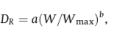
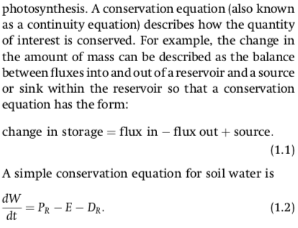
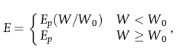
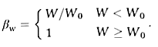
Equations! How much math do you need to know?
β_{w}
1
β_{w}
W₀ – 0.7
0
W
0
0.7
1
Notes:
Won’t just put an equation up and expect you to understand it.
Explain which parts are inputs, which are parameters, which are prognostic variables, which are model formulations/parameterizations
Will plot functions so you can see what it looks like.

Slide 23
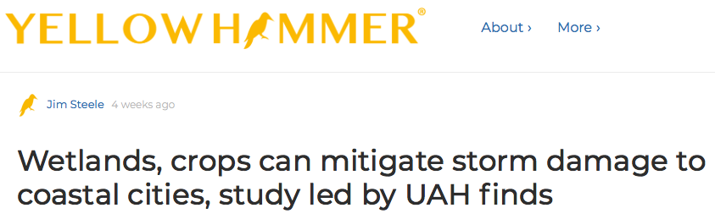
Extra credit
1 extra credit for “In the news” item related to TEMs
Present 1-3 slides at beginning of class
Max 2 extra credits per person

Slide 24
This week…
Class on Wednesday: History of terrestrial ecosystem modeling, earth system modeling, and how all this fits into the IPCC climate change reports
Meanwhile, have a read of Bonan textbook Chapter 1 (provided on Canvas)

